Slide 1


Noida Institute of Engineering and Technology, Greater Noida
Indian Religion, Philosophy, and Practices
(UNIT-III)
UNIT: 3
Essence of Indian Traditional Knowledge
(AMICANC0502 )
Mr. Anshu Kumar
Assistant Professor
Electronics & Communication Engineering
B.Tech ECE VI semester

Slide 2
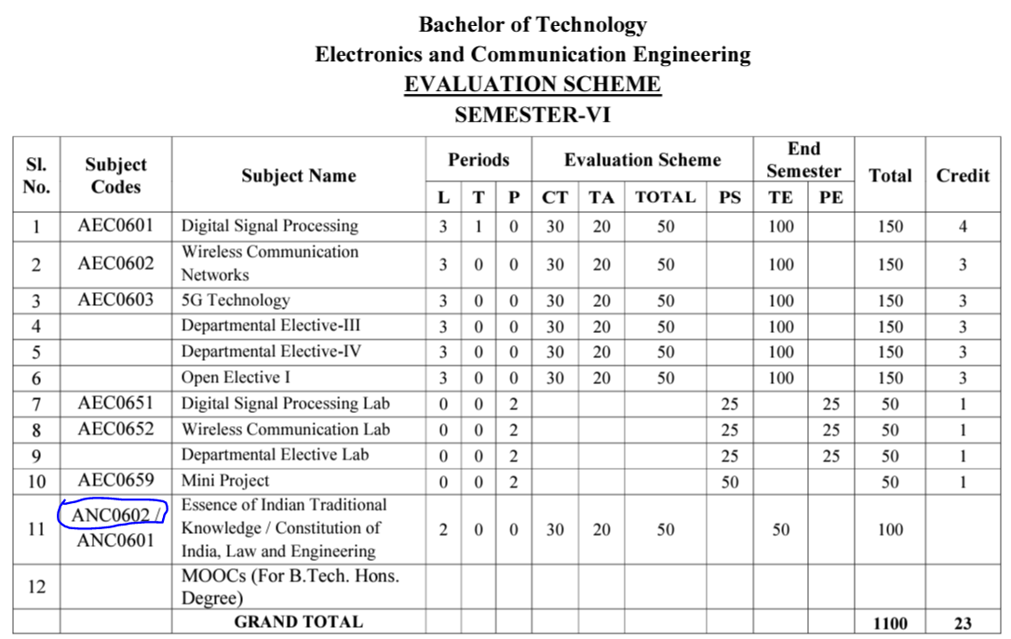
Evaluation Scheme (EC-6th Semester)

Slide 3
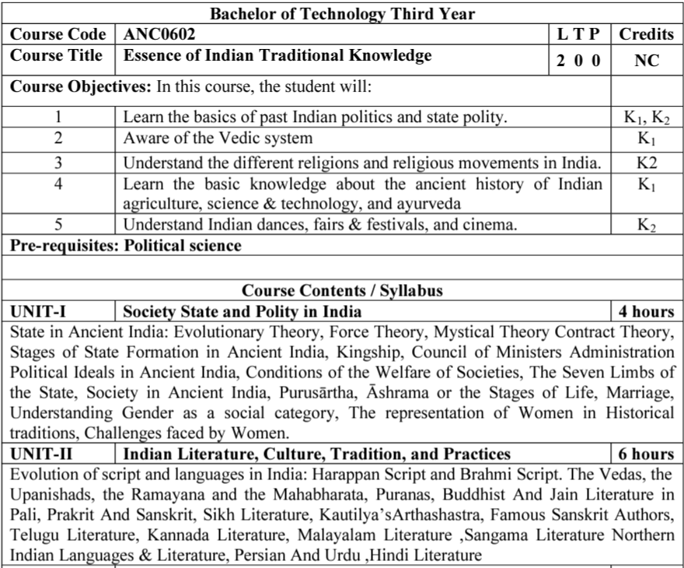
Syllabus

Slide 4
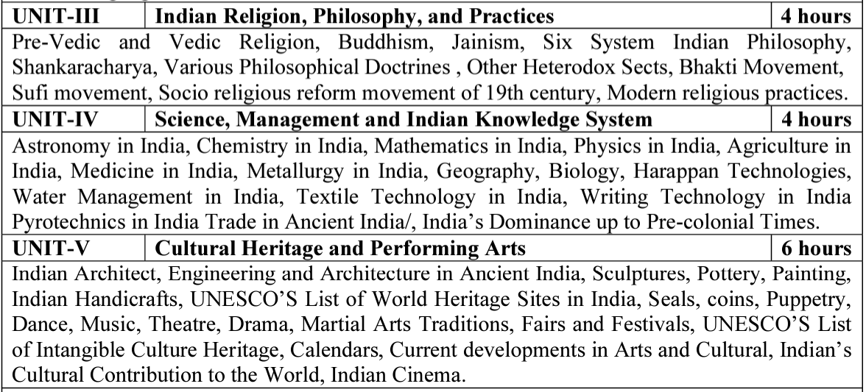
Syllabus(Continue….)

Slide 5
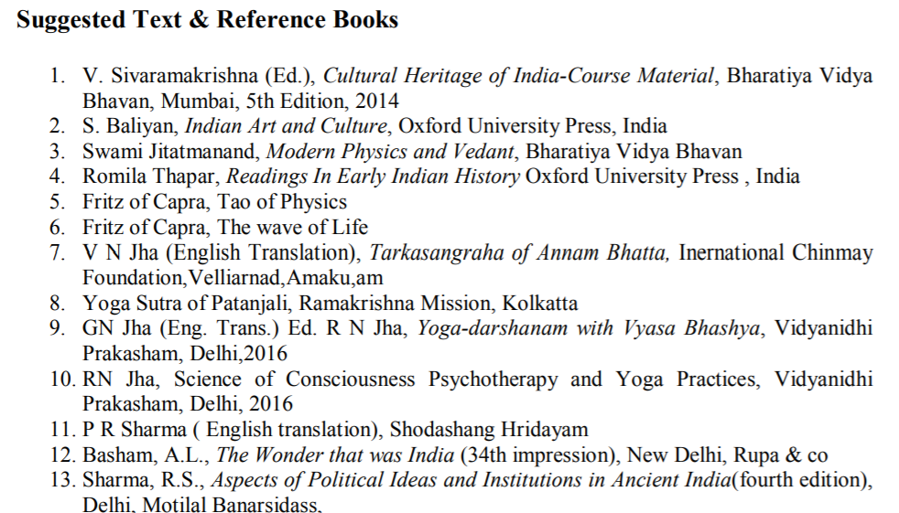
Text Books

Slide 6
Applications of Essence of Indian Traditional Knowledge
Can apply the old designing concept with blend of new trends in building construction
Learn the ancient living style
Indian Traditional knowledge modern scientific perspective
Apply the ancient advanced architectural wonders in current trends

Slide 7
Course Objective
Course Objectives:
The student will try to learn about:
To imparting the basic principles of thought process, reasoning and inference to identify the roots and details of some of the contemporary issues faced by our nation and try to locate possible solutions to these challenges by digging deep into our past.
To enable the students to understand the importance of our surroundings and encourage the students to contribute towards sustainable development.

Slide 8
Course Objective(Continue…)
To sensitize students towards issues related to ‘Indian’ culture, tradition and its composite character.
To make students aware of holistic life styles of Yogic-science and wisdom capsules in Sanskrit literature that are important in modern society with rapid technological advancements and societal disruptions.
To acquaint students with Indian Knowledge System, Indian perspective of modern scientific world-view and basic principles of Yoga and holistic health care system.

Slide 9
Course Outcome
At the end of this course students will able to:
CO1: Understand the basic principles of thought process & inference to identify the roots and details of some of the contemporary issues faced by our nation and try to locate possible solutions to these challenges by digging deep into our past.
CO2: Illustrate the importance of our surroundings and encourage the students to contribute towards sustainable development.
CO3: Interpret the issues related to ‘Indian’ culture, tradition, & its composite character.

Slide 10
Course Outcome (Continue…)
CO4: Aware of holistic life styles of Yogic-science and wisdom capsules in Sanskrit literature that are important in modern society with rapid technological advancements and societal disruptions.
CO5: Acquaint students with Indian Knowledge System, Indian perspective of modern scientific world-view and basic principles of Yoga and holistic health care system.

Slide 11
Program Outcomes
Program Outcomes are narrow statements that describe what the students are expected to know and would be able to do upon the graduation.
These relate to the skills, knowledge, and behavior that students acquire through the programmed.
Engineering knowledge
Problem analysis
Design/development of solutions
Conduct investigations of complex problems
Modern tool usage
The engineer and society
Environment and sustainability
Ethics
Individual and team work
Communication
Project management and finance
Life-long learning

Slide 12
Program Specific Outcomes
Program Specific Outcomes (PSOs) are what the students should be able to do at the time of graduation. The PSOs are program specific. PSOs are written by the department offering the program.
On successful completion of B. Tech. (EC) Program, the Electronics and Communication engineering graduates will be able to:
PSO1: To apply the knowledge of mathematics, science and electronics & communication engineering to work effectively in the industry based on same or related area.
PSO2: To use their skills to work in modern electronics & communication engineering tools, software and equipments to design solutions for complex problems in the related field that meet the specified needs of the society.
PSO3: To function effectively as an individual and as a member or leader of a team by qualifying through examinations like GATE (Graduate Aptitude Test in Engineering), IES (Indian Engineering Services), PSUs (Public Sector Undertakings), TOEFL (Test of English as a Foreign Language), GMAT (Graduate Management Admission Test) and GRE (Graduate Record Examinations in US) etc.

Slide 13
CO-PO and PSO Mapping
CO | PO1 | PO2 | PO3 | PO4 | PO5 | PO6 | PO7 | PO8 | PO9 | PO10 | PO11 | PO12 | PSO1 | PSO2 | PSO3
CO1 | - | - | - | - | - | - | - | 3 | - | - | - | 3 | - | - | -
CO2 | - | - | - | - | - | - | - | 3 | - | - | - | 3 | - | - | -
CO3 | - | - | - | - | - | - | - | 3 | - | - | - | 3 | - | - | -
CO4 | - | - | - | - | - | - | - | 3 | - | - | - | 3 | - | - | -
CO5 | - | - | - | - | - | - | - | 3 | - | - | - | 3 | - | - | -
Avg | - | - | - | - | - | - | - | 3 | - | - | - | 3 | - | - | -
*3= High *2= Medium *1=Low

Slide 14
Program Educational Objectives
The Program Educational Objectives (PEOs) of an engineering degree program are the statements that describe the expected achievements of graduates in their career, and what the graduates are expected to perform and achieve during the first few years after graduation.
PEO1: To have an excellent scientific and engineering breadth so as to comprehend, analyze, design and solve real-life problems using state-of-the-art technology.
PEO2: To lead a successful career in industries or to pursue higher studies or to understand entrepreneurial endeavours.
PEO3: To effectively bridge the gap between industry and academics through effective communication skill, professional attitude and a desire to learn.

Slide 15
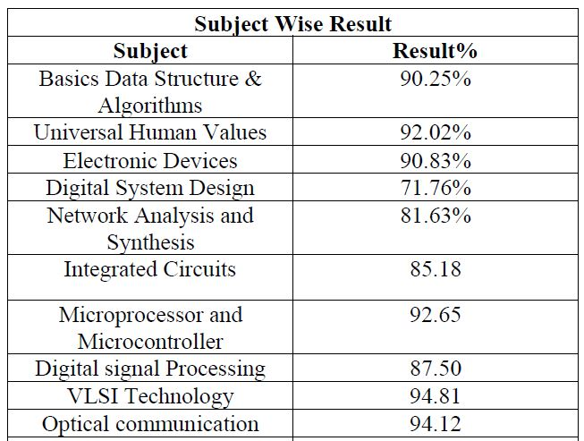
Result Analysis
Faculty Name | Subject Code | Section A | Section B
Mr. Anshu Kumar | ANC 0602 | 100 % | 100 %

Slide 16
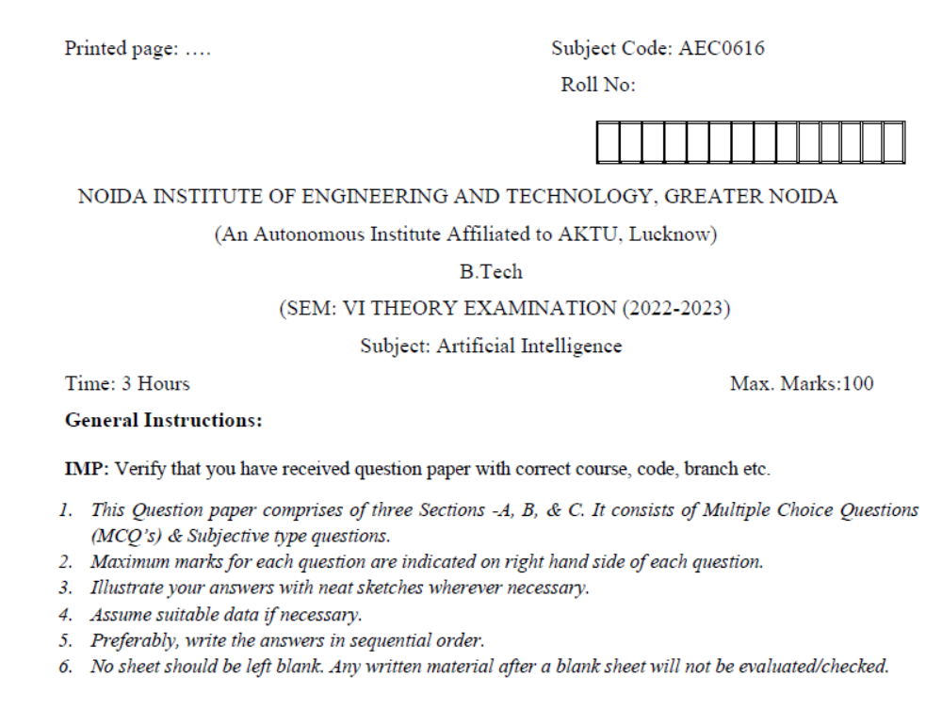
Question Paper Template

Slide 17
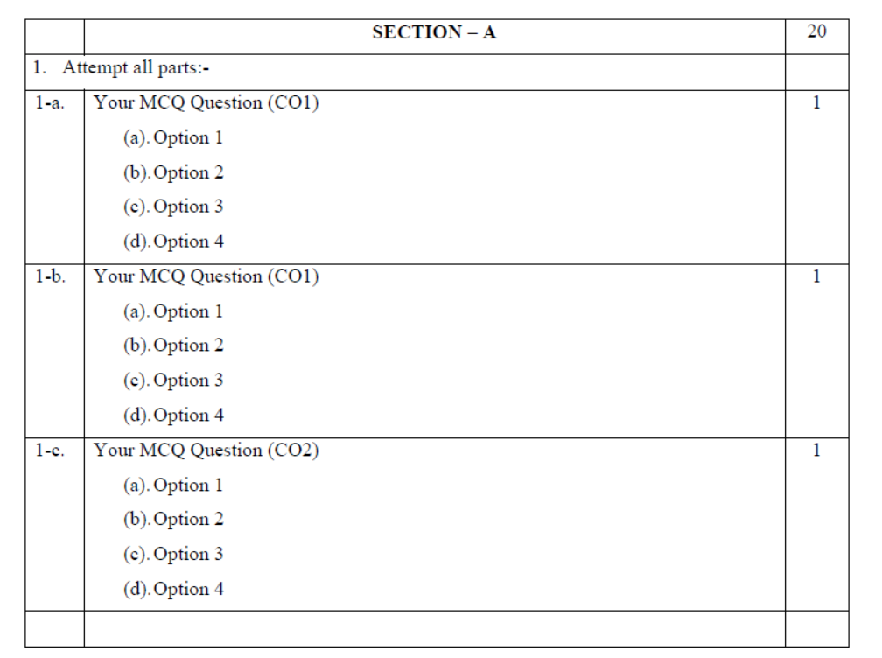
Question Paper Template (Cont……)

Slide 18
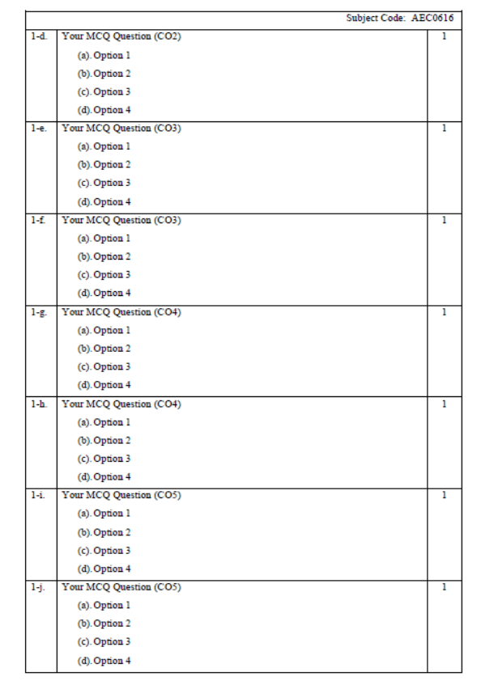
Question Paper Template (Cont……)

Slide 19
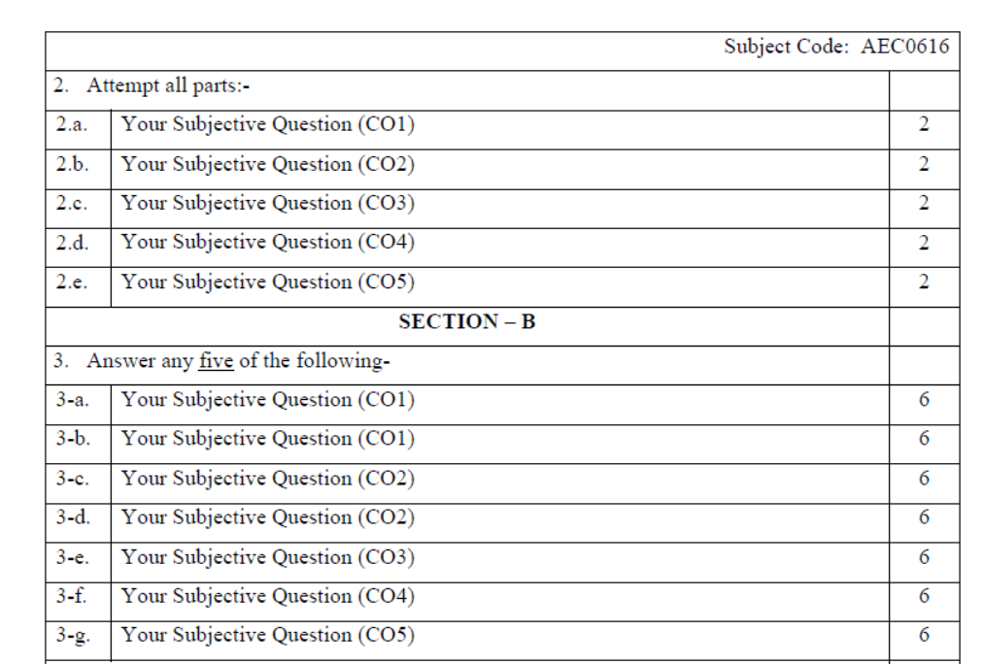
Question Paper Template (Cont……)

Slide 20
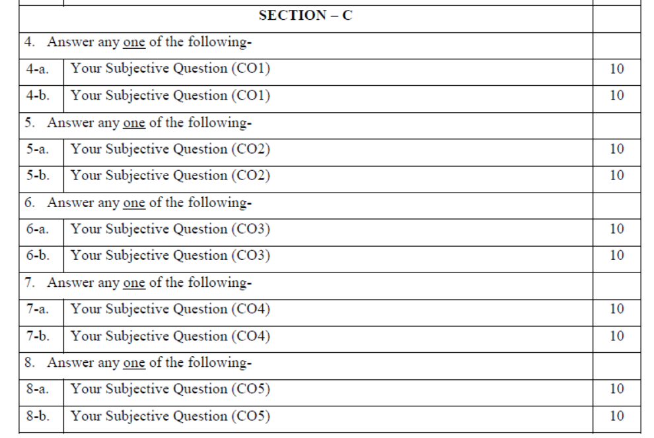
Question Paper Template (Cont……)

Slide 21
Prerequisite and Recap
Basic knowledge of Indian traditions, culture & society.

Slide 22
Brief Introduction about the subject with Video
The course aims at imparting basic principles of thought process, reasoning and inference & to identify the roots and details of some of the contemporary issues faced by our nation and try to locate possible solutions to these challenges by digging deep into our past. To enable the students to understand the importance of our surroundings and encourage the students to contribute towards sustainable development. To sensitize students towards issues related to ‘Indian’ culture, tradition and its composite character.
https://www.youtube.com/watch?v=jgQlf3DM_GU&t=625s

Slide 23
Content
Pre-Vedic and Vedic Religion,
Buddhism,
Jainism,
Six System Indian Philosophy,
Shankaracharya,
Various Philosophical Doctrines ,
Other Heterodox Sects,
Bhakti Movement,
Sufi movement,
Socio religious reform movement of 19th century,
Modern religious practices.

Slide 24
Module 3 Objective
To sensitize students towards issues related to ‘Indian’ culture, tradition and its composite character.

Slide 25
Topic Objective
Topic No. | Topic Objective
1 | To study the Pre-Vedic and Vedic Religion
2 | To study the Buddhism and Jainism

Slide 26
Topic Mapping
S.No. | Topic | Course Outcome
1 | Pre-Vedic and Vedic Religion | CO3
2 | Buddhism & Jainism, | CO3

Slide 27
Pre-Vedic Religion
Religion has been an essential element of human life since the earliest of times.
When the process of evolution of mankind commenced around 2 million years ago ,humans started encountering various complex terrestrial and extra-terrestrial developments.
Unable to comprehend the actual causes behind these phenomena, man started treating them divine and this led to the origin of religious and philosophical ideas.
Graves provide the earliest evidence about religious life of human beings.

Slide 28
Pre-Vedic Religion
Religious life was well developed in India during the days of Harappan civilization.
The archaeological evidences provide exhaustive knowledge about religious beliefs and practices of this great civilization.
The Vedas provide detailed information about religious ideas, beliefs and practices of Vedic Aryans.
Mother Goddess :- Mother goddess was the chief deity of Harappan people as revealed by discovery of large number of female figurines (small images) from Harappan settlements.

Slide 29
Pre-Vedic Religion
Pashupati Shiva :- A male deity termed as Pashupati Shiva was also worshipped by the people of Harappan Civilization. This was revealed by the famous Pashupati Mahadev seal found at Mohenjo-Daro.
Animal worship was practised. Bull was held sacred by people of Harappan civilization.
Pipal tree depicted on some Harappan seals indicate that tree worship was also practised.
The Great Bath found at Mohenjodaro indicates that water worship was also common.

Slide 30
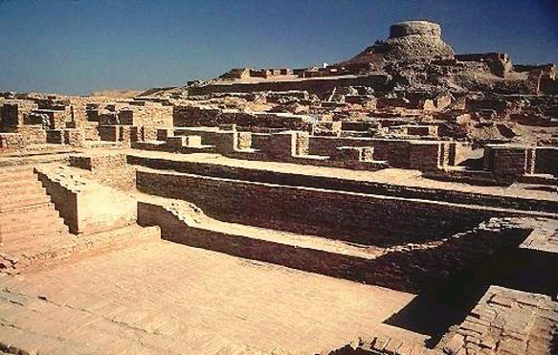
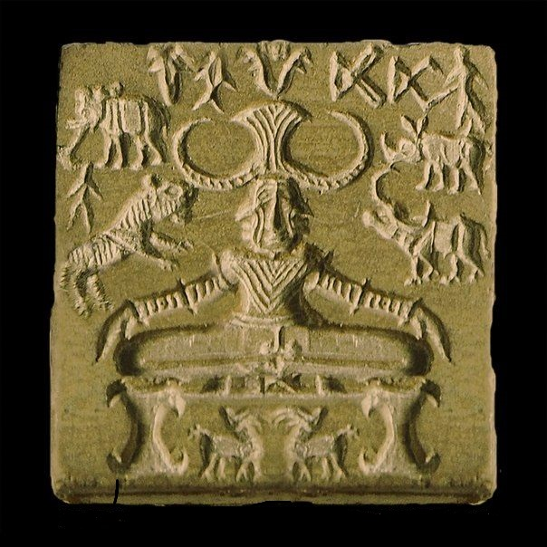
Pre-Vedic Religion
Fig:- Great bath of Mohanjodaro
Fig:- Pashupati seal

Slide 31
Vedic Religion (CO3)
Pre-Vedic Religion
Vedic religion was primarily characterized by personification of the forces of nature. It followed naturalistic polytheism.
The Vedic gods were divided into three categories:
Terrestrial Deities : Agni, Soma, Prithvi
Atmospheric Deities : Indra, Rudra, Marut, Parjanya, Vayu
Celestial Deities : Surya, Varuna, Usha, Vishnu, Asvins, Mitra, Savitr,
Dyaus, Pushan
During the last phase of later Vedic age, a new dimension became visible in religious life which has been described in Upanishads.

Slide 32
Buddhism (CO3)
It is one of the major religions of the world that originated from the Indian sub-continent and has now spread to large parts of South-east Asia.
The origin of Buddhism is attached to the story of Siddhartha who came to be known as Buddha.
The traditions, beliefs and practices in Buddhism are attributed to Buddha.
It is the world’s fourth largest religion after Christianity, Islam and Hinduism.

Slide 33
Buddhism
At the age of 35 on the same day of his birth, he attained enlightenment (Nirvana) under that pipal tree and became Buddha, the Enlightened One.
After attaining Nirvana in Bodh Gaya, he gave his first sermon to his five companions at the Deer Park in Sarnath near Varanasi.
This event was called Dharma-chakra-pravartana (Turning the Wheel of Law).
First five disciples/companions of Buddha (at Sarnath)
1. Kaudinya 2. Bhadrika 3. Vashpa 4. Mahanaman 5. Ashvajit

Slide 34
Buddhism
The three Jewels (triratna) embraced under Buddhism are :
Buddha :- The Enlightened One
Dhamma :- Teachings of Buddha (doctrine)
Sangha :- The Monastic Order
Out of the three jewels or triratnas, the concept of Sangha (the Order) was initiated by Buddha at the time of giving first sermon at Sarnath.
These five companions along with Buddha became a Sangha (a group).
Buddha attained Mahaparinirvana at Kushinagar (Malla Mahajanapada) in Uttar Pradesh at the age of 80 in probably 483 BC.

Slide 35
Buddhism
Four Noble truths. They are:
1. The truth of suffering (Dukkha)
2. The truth of the origin of suffering (Samudaya)
3. The truth of the cessation of suffering (Nirodha)
4. The truth of the path to the cessation of suffering (Marga)
Noble Eightfold Path’. They include:
1. Kind, truthful and Right speech
2. Honest, peaceful and Right action
3. To find the right livelihood which does not harm any being

Slide 36
Buddhism
4. Right effort and cultivating self-control
5. Right mindfulness
6. Right meditation and concentrating on the meaning of life
7. The worth of the sincere and intelligent man is through right thoughts
8. Avoid superstition and cultivate right understanding
After the death of buddha, a need to compile his teachings, and hence four Buddhist Councils were held in a span of next 500 years to collate this material into Pitakas. The result was writing of three major pitakas- Vinaya, Sutta and Abhidhamma, that when combined were called Tripitaka.

Slide 37
Jainism (CO3)
The word ‘Jain’ is derived from jina or jaina which means the ‘Conqueror’.
They believe that their religion is comprised of people who have managed to control and conquer their desires. Jainism does not have a single founder, instead believes that the truth comes to the world in difficult and different times by a teacher who shows the way or a Tirthankara.
There were 23 Tirthankaras or great-learned men in Jain religion before Mahavira. It is commonly mistaken that Mahavira was the founder of Jainism, instead he was the last and 24th tirthankara.

Slide 38
Jainism
Jainism, unlike Buddhism, it believes in the existence of soul (atman).
Soul is the core and the fundamental focus of the Jain philosophy.
It is the soul that experiences existence and gains knowledge, not mind nor body as both are believed to be a heap of matter.
The 24 tirthankaras under Jainism are:
Rishabhanatha or Adinatha, Ajita, Sambhava, Abhinandana, Sumati, Padmaprabha, Suparshva, Chandraprabha, Suvidhi, Shital, Shreyansanath, Vasupujya, Vimala, Ananta, Dharma, Shanti, Kunthu, Ara, Malli, Muni Suvrata, Nami, Nemi, Parshvanatha and Mahavira.

Slide 39
Jainism
Anekantavada is the fundamental doctrine of Jainism emphasises that the ultimate truth and reality is complex and has multiple-aspects. Hence, there exists non-absolutism, that means no single, specific statement can describe the nature of existence and the absolute truth.
They believe that through three-jewel (fold) path of: right belief (Samyak darshana), right knowledge (Samyak gyana) and right conduct (Samyak charitra), one can get rid of the bad karma and also pull themselves out of the cycle of rebirth and achieve salvation. These three jewels or gems of Jainism are called Ratnatraya.

Slide 40
Jainism
Jains need to follow these five constraints in life:
1. Ahimsa (non-violence);
2. Satya (truthfulness);
3. Asteya (not stealing);
4. Aparigraha (non-acquisition) and
5. Brahmacharya (chaste living).

Slide 41
Jainism
Jainism has two major ancient sub traditions:
1. Digambaras [Sub-sects include Mula Sangh (original community) and Terapanthi, Taranpathi and Bispanthi (these three are modern communities)]
2. Svetambaras (Sub-sects include Sthanakavasi and Murtipujaka)
Digambara Terapanthis worship the idols with ashta-dravya just like the Bispanthis, but replace flowers and fruits with dry substitutes.
The Bispanthis worship tirthankaras as well as Yaksha and Yakshini like Bhairava and Kshetrapala.

Slide 42
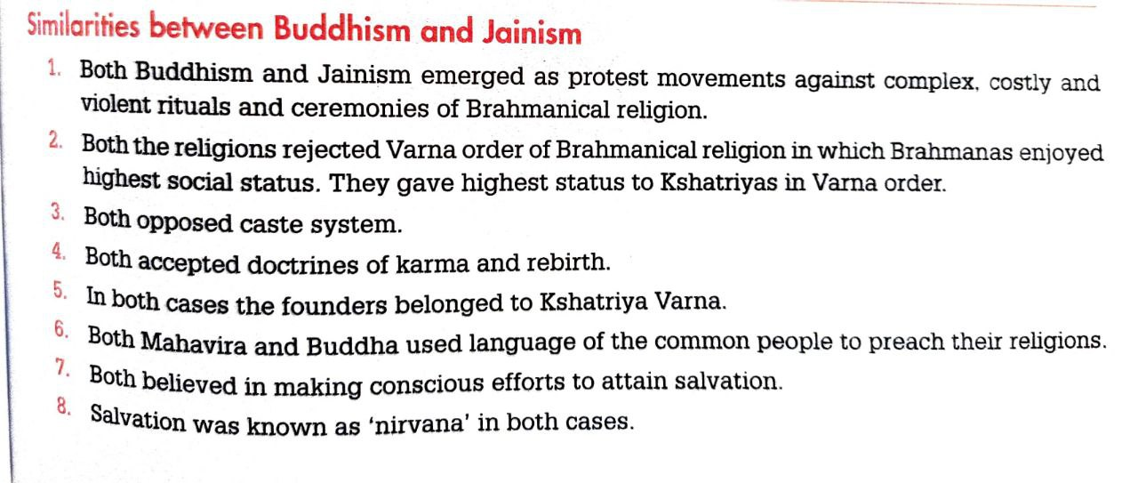
Similarities

Slide 43
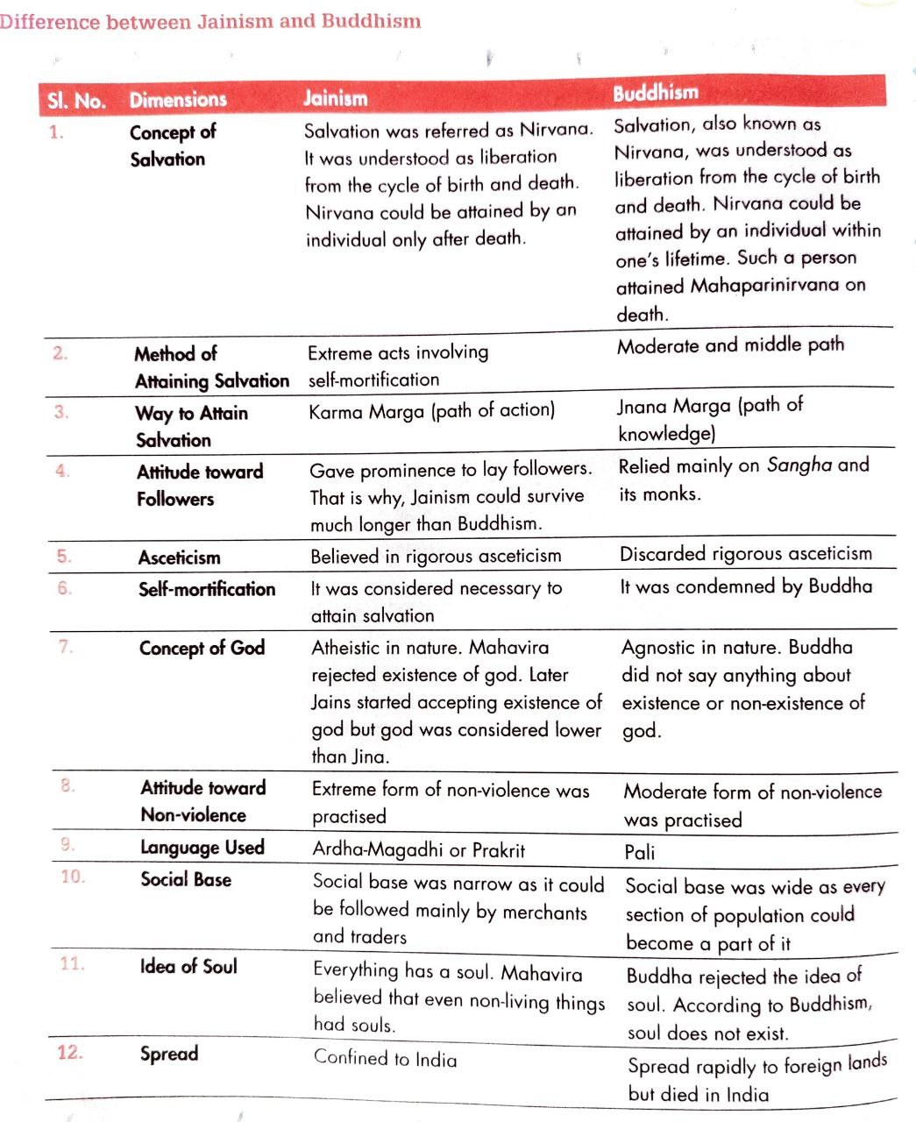
Buddhism Vs Jainism

Slide 44
Recap
In this In this topic, We learned about the Pre-Vedic and Vedic Religion.
We also learned Jainism and Buddhism.

Slide 45
Daily Quiz
Which is not the part of Four Noble truths of Buddhism ?
A. Dukkha
B. Sukkah
C. Samudaya
D. Marga
In Vedic religion which of the following is not the Atmospheric Deity ?
A. Indra,
B. Rudra,
C. Soma
D. Marut
Which one of the following is not the part of Jains constraints in life?
A. Violence
B. Truthfulness
C. Chaste living
D. Non-acquisition

Slide 46
Daily Quiz
How many Noble Path mentioned in Buddhism?
A. Seven
B. Six
C. Eight
D. Five
How many Noble Truth mentioned in Buddhism?
A. Six
B. Five
C. Four
D. Three
How many Jewels are mentioned in Buddhism?
A. Six
B. Five
C. Four
D. Three

Slide 47
Daily Quiz
A male deity during Pre-Vedic times is known as_____.
A. Mother Goddess
B. Pashupati Shiva
C. Bull
D. Pipal
Which one of the following is not the Celestial Deities during Vedic times ?
A. Surya,
B. Marut
C. Varuna,
D. Usha
Which one of the following is the Atmospheric Deities during Vedic times ?
A. Agni,
B. Rudra
C. Soma,
D. Prithvi

Slide 48
Weekly Assignment
Explain the Vedic religion and pre Vedic religion.
Explain Four Noble truths of Buddhism.

Slide 49
Prerequisite
Basic knowledge of Indian Religion
Ancient History after Vedic era.
Basic knowledge of Philosophy.

Slide 50
Topic Objective
Topic No. | Topic Objective
1 | To understand the Six System Indian Philosophy
2 | To study the Shankaracharya & Various Philosophical Doctrines

Slide 51
Topic Mapping
S.No. | Topic | Course Outcome
1 | Six System Indian Philosophy | CO1& CO3
2 | Shankaracharya, Various Philosophical Doctrines | CO1& CO3

Slide 52
Indian Philosophy
Orthodox School :- This school believed that Vedas were the supreme revealed scriptures that hold the secrets to salvation. They did not question the authenticity of the Vedas. They had six sub schools that were called the Shada Darshana: Samkhya, Yoga, Nyaya, Veisheshika, Mimamsa and Vedanta.
Heterodox School :- They do not believe in the originality of the Vedas and questioned the existence of God. They are divided into three major sub schools: Buddhism, Jainism, Lokayata.
Astika: The system of thought which admit the validity of the Vedas are called Astika.
Nastika: The system of thought which repudiate the validity of the Vedas are called Nastika.

Slide 53
Six System Indian Philosophy
(Shada darshana)
Samkhya School of Philosophy :-
This is the oldest school of philosophy and was founded by Kapil Muni who is supposed to have written the Samkhya Sutra.
The word ‘Samkhya’ or ‘Sankhya’ literally means ‘count’.
Shashti-tantra written by Kapila Muni is the principal text of this school.
Samkhya philosophy emphasizes that the world was not created by some divine agency. Nature or Prakriti created this world.
This school believed in dualism or dvaitavada, i.e. the soul and the matter are separate entities.

Slide 54
Six System Indian Philosophy
This school has been famous for their scientific system of inquiry. The final philosophy argued that Prakriti and Purusha are the basis of reality and they are absolute and independent.
Prakriti consists of three major attributes: thought, movement and transformation.
Vaisheshika School of Philosophy :-
Uluka Kanada was its founder. He was also known as Kashyapa & Kanubhuk.
Kanada Sutras is the principal test of this school.

Slide 55
Six System Indian Philosophy
It believes that Universe is made up of 5 fundamental atomic elements and each of these element has special characteristics(Vishesta).That is why ,this school is known as Vaisheshika. These five fundamental atomic elements are elements: Fire, Air, Water, Earth and ether (sky).
It also recognizes existence of four fundamental non-atomic elements. These are : Time, Space, Soul & Mind.
NYAYA School of Philosophy :-
As the name of the school suggests, they believe in the technique of logical thinking to achieve salvation.
This is also know as the school of logic and analysis.

Slide 56
Six System Indian Philosophy
Akshapada Gautama was the founder of this school.
Nyaya Sutras composed by Gautama is the principal text of this school.
It recognizes 4 fundamental sources of knowledge. These are
Pratyaksha (Perception), Anumana(Inference),Upamana(Comparision) & Shabda (Verbal testimony).
The school argues that by using logical tools like inference, hearing and analogy; a human being could verify the truth of a proposition or statement.
Clear thinking and logical arguments are considered essential to attain salvation.

Slide 57
Six System Indian Philosophy
YOGA School of Philosophy:
Patanjali was the founder of this school.
Patanjali’s Yoga sutras is the Principal text of this school.
Practice of control over bodily organs, pleasure and senses is central to the philosophy of this system.
The Yoga school literally means the union of two major entities. They argue that human being can achieve salvation by combining meditation and physical training(asana) of yogic techniques.
‘Om’ is considered as a scared symbol.

Slide 58
Six System Indian Philosophy
MIMAMSA School of Philosophy:
Maharishi Jaimini was the founder of this school.
Jaimini sutras (also known as Upadesha sutras) is the principal text of this school.
The word ‘Mimamsa’ literally means the art of reasoning, interpretation and application. This school focuses on the analysis of the texts of Samhita and Brahmana that are portions of the Vedas.
Attaining salvation and reaching heaven is the main object of the philosophy of this school.

Slide 59
Six System Indian Philosophy
VEDANTA School of Philosophy:
Badarayana was the founder of this school.
Badarayana’s Brahma sutra is the principal text of this school.
Vedanta is made of two words- ‘Veda’ and ‘ant’, i.e. the end of the Vedas. This school upholds the philosophies of life as elaborated in the Upanishads. It is also known as ‘ Uttar Mimamsa’ or ‘Jnana Mimamsa’.
But this philosophy evolved in 9th century AD through the philosophical intervention of Shankaracharya who wrote commentaries on the Upanishads and the Bhagavad Gita. His changes led to the development of Advaita Vedanta. Ramanujam was another philosopher of this school.

Slide 60
Shankaracharya (CO1& CO3)
The word Shankaracharya, is composed of two parts, ‘Shankara’ and ‘Acharya’. Acharya is a Sanskrit word meaning "teacher", so Shankaracharya means "teacher of the way of Shankara“.
Shankaracharya’s philosophy is called Advaita (monism).
According to this philosophy Brahma is the realty. Only Brahma exists. It can be summed up in his own words ‘ Brahma Satya, Jagat Mithya’.
Shankara considered Brahma to be without any attributes(i.e Nirguna).
Shankara Wrote commentaries on 11 main Upanishads.
Shankara started Panchayatana system in which 5 deities are worshipped together.

Slide 61
Shankaracharya
These deities are Shiva, Parvati, Ganesha, Vishnu & Surya.
This helps in integration of different religious groups of India. Because of this he is referred as Shanmata Sthapanacharya.
Shankara established 4 monasteries in different corners of India. These were
1. Kalikapeeta at Dwarka in West
2. Jyotirmatha at Badrinath in North
3. Govardhanapeeta at Jagannath Puri in East
4. Sharadhapeeta at Sringeri (Chikkamagaluru, Karnataka) in South

Slide 62
Various Philosophical Doctrines
(CO3)
Propounder | Doctrine
Shankaracharya | Advaitavada (Monism)
Ramanujacharya | Vishishta Advaitavada(Qualified Monism)
Madhavacharya | Dwaitvada
Vallabhacharya | Shuddh-Advaitavada (Pure Monism)
Nimbarkacharya | Vishishta Advaitavada
Bhaskaracharya | Bheda-bhedavada
Chaitanya | Achintya-Bhedabhedavada
Vijnanabhikshu | Avibhagadvaita
Sripati | Vir Shiva Vishishtadvaitavada
Srikantha | Shaiva Vishishtadvaitavada
Basava | Shakti-Vishishtadvaitavada

Slide 63
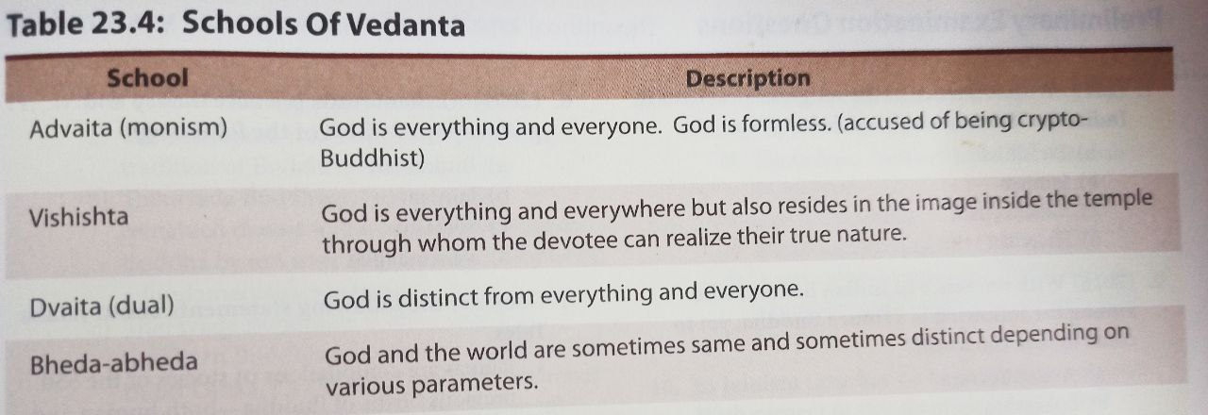
Various Philosophical Doctrines

Slide 64
Recap
In this In this topic, We learned the Shankaracharya & Various Philosophical Doctrines.
We have also learned about Six System Indian Philosophy.

Slide 65
Daily Quiz
Who was the Propounder of Advaitavada (Monism)?
A. Ramanujacharya
B. Shankaracharya
C. Chaitanya
D. Vallabhacharya
_____ was the founder of Nyaya school of philosophy.
A. Uluka Kanada
B. Patanjali
C. Akshapada Gautama
D. Maharishi Jamini
Which one of the following is not the part of Panchayatana system?
A. Shiva,
B. Parvati
C. Ganesha
D. Jamini

Slide 66
Daily Quiz
_____ was the founder of Vaisheshika School of Philosophy.
A. Uluka Kanada
B. Patanjali
C. Kapil Muni
D. Maharishi Jamini
_____ was the founder of Samkhya School of Philosophy.
A. Uluka Kanada
B. Patanjali
C. Kapil Muni
D. Maharishi Jamini
_____ was the founder of Yoga School of Philosophy.
A. Uluka Kanada
B. Patanjali
C. Kapil Muni
D. Maharishi Jamini

Slide 67
Daily Quiz
Who was the Propounder of Achintya-Bhedabhedavada?
A. Ramanujacharya
B. Shankaracharya
C. Chaitanya
D. Vallabhacharya
Who was the Propounder of Vir Shiva Vishishtadvaitavada?
A. Ramanujacharya
B. Shankaracharya
C. Chaitanya
D. Sripati
Buddhism are the part of Heterodox school of philosophy.
B. True
C. False

Slide 68
Weekly Assignment
Explain the orthodox school of philosophy of Ancient India in detail.
What are the differences between orthodox school of philosophy and Heterodox school of philosophy?
Explain the philosophy of Shankaracharya and also explain Shanmata Sthapanacharya.

Slide 69
Prerequisite
Basic knowledge of Indian traditions, culture & Religion.
Basic knowledge of reform movement

Slide 70
Topic Objective
Topic No. | Topic Objective
1 | To study the Other Heterodox Sects, Bhakti Movement & Sufi movement
2 | To study the Socio religious reform movement of 19th century
3 | To study the Modern religious practices

Slide 71
Topic Mapping
S.No. | Topic | Course Outcome
1 | Other Heterodox Sects, Bhakti Movement & Sufi movement | CO1& CO3
2 | Socio religious reform movement of 19th century | CO1& CO3
3 | Modern religious practices | CO1& CO3

Slide 72
Other Heterodox Sects (CO1& CO3)
UCHCHEDAVADA (ANNIHILATIONISM) :-
It was founded by Ajita Kesakambalin.
He was a contemporary of Mahatma Buddha.
This Sects believed in materialistic philosophy.
He was of the opinion that everything ends with death.
He did not believe in idea of sin. He said that there was no sin and a person could do anything.
He asked his follower to enjoy the pleasure of this world.
Charvaka or lokayata school emerged out of it.

Slide 73
Other Heterodox Sects
NIYATIVADA OR AJIVIKAS :-
It was established by Nanda Vachcha.
Makkhaliputta Gosala popularized it.
Its philosophy was based on Niyati (Destiny).
It rejects the theory of Karma.
MATERIALISM/CHARVAKAS/LOKAYATAS :-
It was also known as Barhaspatya. Its followers were known as Charvakas or Lokayatas.
Barhaspatya sutras is the primary literature of Charvakas.

Slide 74
Other Heterodox Sects
‘Live well as long as you live. Live well even by borrowing because once cremated there is no return’ – This was the fundamental belief of this sect.
The monks of this sect were also known as Nastika Shiromani.
AKRIYAVADA/ANTINOMIANISM :-
Purana Kasyapa was its founder.
It believed that soul was different from body. The soul remains unaffected by anything that happens to the body. It believed in the doctrine of non-action.
It emphasized that action do not result in either merit or demerit.

Slide 75
Other Heterodox Sects
AKRITTAVADA/ASASVATAVADA :-
Pakuda Katyayana was the founder of this sect.
According to its philosophy,7 elements(Nikayas) constitute this universe.
These are Light, Sorrow, Happiness, Earth, Water, Air, Life.
These elements are fundamental and they could neither be created nor destroyed.
ANICHCHITVADA :-
Sanjay vetiputta was the founder of this sects. The theory of uncertainty was put forward by it. The ‘ doctrine of non-denial and non –approval of existence of anything’ is associated with it.

Slide 76
Bhakti Movement (CO1& CO3)
The Bhakti movement originated in the Southern parts of India, especially Tamil Nadu between 6th and 10th century AD; it slowly percolated to the Northern belt by the end of 15th century.
Bhakti means a way of connecting to god.
Bhakti saints like Kabir, Guru Nanak and Ravidas targeted socio-religious evils prevailing in India during that time.
The Bhakti movement was simple, liberal and progressive in nature.
The idea of peaceful co-existence was propagated by Bhakti saints. They believe in oneness of god. They adopted positive elements from both Hinduism and Islam.

Slide 77
Bhakti Movement
Main Features of the Bhakti Movement
Intense love and devotion as the means of salvation.
Unity of God (Universalism) and repeating the one true name again and again
Rejection of rituals and ceremonies
No caste discrimination and keeping an open mind on religious and gender issues. They allowed both men and women to seek salvation. They even took their meals together from the common kitchen. They condemned woman infanticide and Sati practice.

Slide 78
Bhakti Movement
Main Features of the Bhakti Movement
Using local and regional languages to spread their messages
They stressed on the idea of a personal God
Need of a true Guru (teacher)to realise God
They propagated equality and spirit of brotherhood like the Sufis
They despised priests who they thought were middlemen and instead focused on establishing a personal connection with God

Slide 79
Bhakti Movement
The two Schools of Bhakti: Saguna School/Nirguna School
The Bhakti saints were divided into two schools depending on the way they imagined God.
One school of thought imagined God as formless with no attributes or quality. This school of thought is the Nirguna School. They are more focused on acquiring knowledge.
They rejected the scriptures and condemned every form of idol worship. The prominent figures of this school of thought were Kabir, Guru Nanak and Dadu Dayal.

Slide 80
Bhakti Movement
The two Schools of Bhakti: Saguna School/Nirguna School
On the other hand, the Saguna School thought of God as having a definite form, quality and positive attributes and the god manifests himself in incarnations such as Rama and Krishna.
His spirit is to be found in the idols and images worshipped at home and in temples. The Saguna School emphasises on love and devotion.
They accept the spiritual authority of the Vedas and the need of a human Guru as mediator between God and his devotee.
Ramanuja, Ramananda and Chaitanya Mahaprabhu belonged to this school of thought.

Slide 81
Bhakti Movement
Prominent Bhakti Saints
Name | Year and Place | Details
Ramananda | 1300-1380 AD Uttar Pradesh | He was a Vaishnava saint and considered to be the founder of Ramanand sampradaya which is the largest ascetic community in India. He was a devotee of Lord Rama. He made an attempt towards a synthesis between Advaita Vedanta and Vaishnava bhakti.
Kabir | 1440AD-1510 AD Uttar Pradesh | He believed in Vaishnavism and had a strong bent to monist Advaita philosophy signifying presence of God inside every person and everything. He was the disciple of Ramananda. His followers are known as Kabir panthis.

Slide 82
Bhakti Movement
Prominent Bhakti Saints
Name | Year and Place | Details
Ravidas/ Raidas | 1398-1540 AD | He was the founder of Raidas Panth. He lived in Banaras. Over 30 hymns composed by him were collected in Guru Granth Sahib of the sikhs. Queen Jhali of Chittor was one of his disciples.
Guru Nanak | 1469-1539 AD Punjab | He is said to have been inspired by Kabir and belonged to Nirguna school. He was the first among the 10 Sikh gurus and is the founder of Sikhism.

Slide 83
Bhakti Movement
Prominent Bhakti Saints
Name | Year and Place | Details
Ramanuja | 1017-1137 AD Tamil Nadu | He was a major exponent of Sri Vaishnavism tradition and the chief proponent of the Vish-ishtadvaita sub school of Vedanta philosophy. Srirangam Ranganatha temple in Tamil Nadu is associated with his tradition.
Madhvach-arya (Kannada Saint) | 1238-1317 AD Karnataka | He was the chief proponent of Dvaita (dualism) School of Vedanta philosophy. He named his philosophy as “Tatvavada”. He was a critic of Adi Shankara’s Advaita Vedanta & Ramanuja’s VishishtadvaitaVedanta.

Slide 84
Sufi Movement (CO1& CO3)
Origin
Sufism is the mystical arm of Islam and is better known as tasawwuf. It stresses on self realisation, tolerance, righteousness and universal love for all.
The word finds its roots in Arabic word for wool (suf), indicative of the garments of rough wool worn by the ascetics and even the prophets.
The word Sufism is sometimes also traced to root word safa which in Arabic means purity.
Sufis emphasized divine unity by arousing spiritual facilities.

Slide 85
Sufi Movement
The Sufis tried to purify their inner self by rigid introspection and mental struggle so as to remove even the smallest sign of selfishness and attain ikhlas, (absolute purity of intention and act).
The mystics realised that beyond the knowledge of outward sciences, intuitive knowledge was required in order to receive that illumination to which reason has no access.
Sufism strictly follow the concept of pir-murshidie. (similar to Guru- Shisya tradition).
The ultimate goal of Sufism is Union with God.

Slide 86
Sufi Movement
According to Sufism, Love of God meant love towards humanity and they believe service to humanity equals service of God.
Sufism inculcated a spirit of tolerance among its followers.
The essential characteristics of Sufism are:
Fana: Spiritual merger of devotee with Allah
Insan-e-kamil: Perfect human with all good virtues,
Zikr-tauba: Remembrance of god all the time(zikr),
Wahadat-ul-wajood: One god for entire universe; unity of god and being.
Sama: Spiritual dance and music to promote their concepts.

Slide 87
Sufi Movement
They believed in the equality of all human beings and universal brotherhood of man.
Most of the Sufis use the vocabulary of love and intimate affection while describing their experience with god. It was a badge of honor for the Sufi to be known as the lover of god or Sufi masters.
The Sufis came to be organised into orders or ‘silsilas’.
Ain-I –Akbari written by Abul Fazl mentions a dozen silsilahs.
Prominent Silsilahs or Sufi orders were – Chishti, Suhrawardi, Firdausi, Qadariya, Naqshbandi, etc.

Slide 88
Socio religious reform movement of 19th century
BRAHMO SAMAJ :-
It was one of the earliest socio-religious reform movement in India in the 19th Century. It was started by Raja Ram Mohan Roy.
This movement laid the foundations for emergence of modern India.
It inspired generation of Indians to fight for revitalization of Indian culture and liberation of India from British colonial rule.
Brahmo Samajists have no faith in any scripture as an authority.
Brahmo Samajists have no faith in Avatars
Brahmo Samajists denounce polytheism and idol-worship.

Slide 89
Socio religious reform movement of 19th century
ARYA SAMAJ :-
Swami Dayanand Saraswati was the founder of it in 1875.
Arya Samaj opposed socio-religious evils like untouchability, child marriage, caste discrimination, idolatry, polytheism, belief in charms, magic and animal sacrifices.
Between 1869 and 1873, Dayanand began his efforts to reform orthodox Hinduism in India. He established Gurukul (Vedic schools) which emphasised Vedic values, culture, Satya (virtue) and Sanatana Dharma (the essence of living). The schools gave separate educations to boys and girls based on ancient Vedic principles.

Slide 90
Socio religious reform movement of 19th century
RAMAKRISHNA MISSION :-
Ramakrishna mission was officially established in 1896 by Swami Vivekanand. Its headquarter was located at Belur near Calcutta.
According to Ramakrishna, it was service to man and not mercy that should be regarded as god.
The organization mainly propagates the philosophy of Vedanta–Advaita Vedanta and four yogic ideals–jnana, bhakti, karma, and raja yoga.
The mission's activities cover the areas such as Education, Health care, Cultural activities, Rural uplift, Tribal welfare & Youth movement etc.

Slide 91
Socio religious reform movement of 19th century
ALIGARH MOVEMENT :-
It was started by Sir Sayyid Ahmed Khan in 1864.
This movement was guided by liberal interpretation of Quran.
It propagated western scientific education among Muslim masses.
DEOBANDI MOVEMENT :-
It was started by Rashid Ahmad Gangohi and Muhammad Qasim Nanautavi in 1867.
It made educational efforts to uplift Muslims.
It was an anti-British movement.

Slide 92
Socio religious reform movement of 19th century
ARYA MAHILA SAMAJ :-
It was founded by Ramabai.
Its aim was to create a support network for newly educated women.
BHARAT STREE MAHAMANDAL :-
It was founded at Allahabad in 1910.
It was the first permanent association dedicated to the cause of Indian women.
Sarala Devi Chaudhurani participated actively in Swadeshi Movement.
She founded Laksmir Bhandar in 1904. Propagated hand –woven clothes.

Slide 93
Modern religious practices (CO1& CO3)
HINDUISM:-
Hinduism is one of the biggest religions in this country but has a variety of cults and sects within its purview.
Hinduism is a word that is drawn from ‘Hindu’, which was meant as a term to connote people who lived in the geographical area around the river Indus. At the most basic level,
Hinduism borrows its basic principles from pre-Vedic and Vedic religious philosophies.
Veda, Upanishad, Puranas, Bhagavat Gita, Ramayana & Mahabharata are the text of Hinduism.

Slide 94
Modern religious practices
ISLAM:-
Islam originated in the Arabian Peninsula in the 7th century AD and spread over the world through a large empire.
The basic tenants of Islam are that there is only one Allah (manifestation of god) who sent his messenger to help the people on Earth and Prophet Muhammad was the last Prophet.
Quran is the holy text in Islam.
According to Prophet, one has to give a portion of their earnings to the needy and the poor and is called Zakat or charity.

Slide 95
Modern religious practices
CHRISTIANITY:-
The largest religion of the world, Christianity has a lot of followers in India.
It was founded by Jesus Christ in Jerusalem and after his prosecution and resurrection after three days, it started to get more and more followers.
The basis of the Roman Catholic Christianity became Vatican City.
The basic philosophy of Christianity is the existence of one God who created the Universe.
The sacred text of the Christians is Bible.

Slide 96
Modern religious practices
SIKHISM:-
The history of Sikhism commences with the life, times and teachings of Guru Nanak (1469–1539).
Guru Nanak did not merely denounce or condemn the existing social order but he gave an alternative to it. For him, the supreme purpose of human existence was salvation which can be attained by getting relieved from the endless cycles of birth and rebirth.
Guru Granth Sahib is the holy text in Sikhism which contain the bani of the Sikh saints.

Slide 97
Modern religious practices
ZOROASTRIANISM:-
This religion has its origin in Persia by the prophet Zarathustra around 7th century BC. They are a monotheistic religion who believe in one eternal god whose name is Ahura Mazda who is the epitome of just behaviour and goodness.
Their sacred text called Zend Avesta is written in Old Avestan and consists of 17 sacred songs (gathas) and the Athuna Vairyo (sacred chant), which was supposedly written by Zarathustra himself.
The translations of these texts and compiled glossaries are called Zend.

Slide 98
Modern religious practices
JUDAISM:-
It is one of the oldest religions and yet it has been prosecuted the most.
The followers of Judaism are called Jews and several empires had targeted them.
The Jews believe in Yahweh or the one true God who was instituted by Abraham.
Their religious book is called the Torah, which is also the first five books of the larger text Tanakh.
Abraham was the ancestor of all Jews and propounded that those who followed the injunctions of God would be blessed.

Slide 99
Recap
In this In this topic, We learned the Other Heterodox Sects, Bhakti
Movement & Sufi movement and the Socio religious reform movement
of 19th century
We also learned about the Modern religious practices.

Slide 100
Daily Quiz
Queen Jhali of Chittor was the disciple of _____?
A. Ramananda
B. Ravidas
C. Kabir
D. Guru Nanak
_____ was the founder of ARYA MAHILA SAMAJ .
A. Sarala Devi Chaudhurani
B. Swami Dayanand Saraswati
C. Ramabai
D. Maharishi Jamini
The ultimate goal of Sufism is Union with God.
A. True
B. False

Slide 101
Daily Quiz
DEOBANDI Movement started by _______ .
A. Sarala Devi Chaudhurani
B. Rashid Ahmad Gangohi
C. Raja Ram Mohan Roy
D. Maharishi Jamini
_____ was the founder of BRAHMO SAMAJ .
A. Sarala Devi Chaudhurani
B. Swami Dayanand Saraswati
C. Raja Ram Mohan Roy
D. Maharishi Jamini
ZOROASTRIANISM are a monotheistic religion.
A. True
B. False

Slide 102
Daily Quiz
The religious book of Judaism is known as ____.
A. Bhagavat Gita
B. Zend Avesta
C. Torah
D. Bible
The religious book of Zoroastrianism is known as ____.
A. Bhagavat Gita
B. Zend Avesta
C. Torah
D. Bible
Zoroastrianism are a monotheistic religion.
A. True
B. False

Slide 103
Weekly Assignment
Explain the social reform movement started during19th century.
Explain Bhakti and Sufi movement in detail.

Slide 104
Video Link
(Art and Culture)
https://www.youtube.com/watch?v=wjepzXnEqYo

Slide 105
Faculty Video Links, YouTube & NPTEL Video Links and Online Courses Details
YouTube/other Video Links
https://www.youtube.com/watch?v=wjepzXnEqYo
https://www.youtube.com/watch?v=qejQVizxcuU
https://www.youtube.com/watch?v=a9ffLxZr8LA
https://www.youtube.com/watch?v=OJ3Ei4Bdz7g
https://www.youtube.com/watch?v=F2tqV9u9vzY

Slide 106
MCQs
_____ was the founder of Vaisheshika School of Philosophy.
A. Uluka Kanada
B. Patanjali
C. Kapil Muni
D. Maharishi Jamini
_____ was the founder of Samkhya School of Philosophy.
A. Uluka Kanada
B. Patanjali
C. Kapil Muni
D. Maharishi Jamini
_____ was the founder of Yoga School of Philosophy.
A. Uluka Kanada
B. Patanjali
C. Kapil Muni
D. Maharishi Jamini

Slide 107
MCQs
In which one of the following matters does Jainism differ from Buddhism?
A. Acceptance of the doctrine of Karma
B. Rejection of the authority of the Vedas as spiritual guides
C. Emphasizing ethical rules of life
D. Attachment to severe asceticism
Who was the teacher of Adi Shankara?
A. Patanjali
B. Ramanujam
C. Govinda Bhargavatpada
D. Kapila Muni

Slide 108
MCQs
A male deity during Pre-Vedic times is known as_____.
A. Mother Goddess
B. Pashupati Shiva
C. Bull
D. Pipal
Which one of the following is not the Celestial Deities during Vedic times ?
A. Surya,
B. Marut
C. Varuna,
D. Usha
Which one of the following is the Atmospheric Deities during Vedic times ?
A. Agni,
B. Rudra
C. Soma,
D. Prithvi

Slide 109
MCQs
DEOBANDI Movement started by _______ .
A. Sarala Devi Chaudhurani
B. Rashid Ahmad Gangohi
C. Raja Ram Mohan Roy
D. Maharishi Jamini
_____ was the founder of BRAHMO SAMAJ .
A. Sarala Devi Chaudhurani
B. Swami Dayanand Saraswati
C. Raja Ram Mohan Roy
D. Maharishi Jamini
ZOROASTRIANISM are a monotheistic religion.
A. True
B. False

Slide 110
Glossary Questions
Pick the correct answer from given Glossary
Uluka Kanada Patanjali Govinda Bhargavatpada Kapil Muni
______ was the teacher of Adi Shankara.
______ was the founder of Vaisheshika School of Philosophy.
_____ was the founder of Samkhya School of Philosophy.
_____ was the founder of Yoga School of Philosophy.

Slide 111
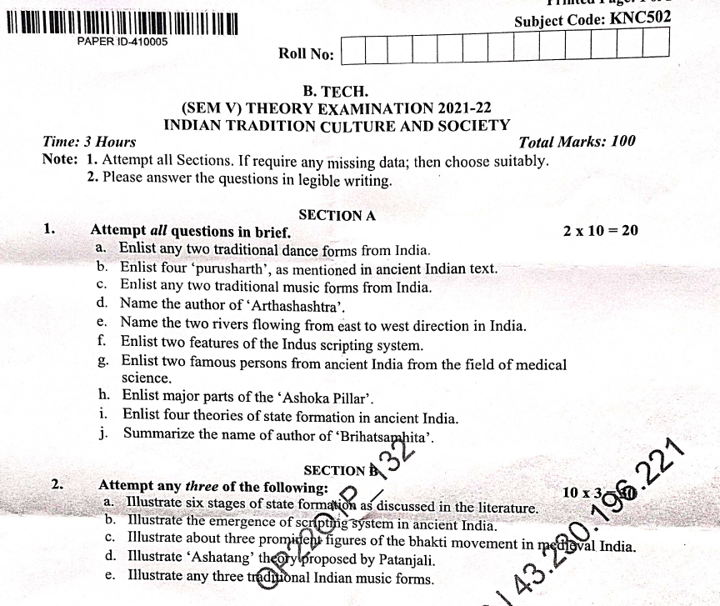
Old Question Papers

Slide 112
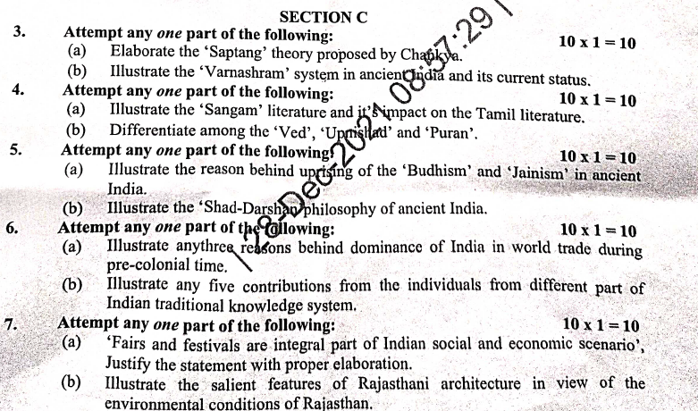
Old Question Papers

Slide 113
Expected Questions for University Exam
Explain the philosophy of Shankaracharya and also explain Shanmata Sthapanacharya.
Enlist the different philosophical doctrines and write the difference between Shankaracharya’s philosophy & Ramanujacharya's philosophy.
Discuss the four stages of a human life as indicated in Upanishads.
Explain the social religious institutions during 19th century.
Explain Bhakti and Sufi movement in detail.

Slide 114
Recap of unit
In this unit, we learned about Pre-Vedic and Vedic Religion.
We also studied, Buddhism, Jainism, Six System Indian Philosophy, Shankaracharya, Various Philosophical Doctrines.
In this unit, we learned about Other Heterodox Sects, Bhakti Movement, Sufi movement.
We also studied, Socio religious reform movement of 19th century, Modern religious practices.

Slide 115
References
V. Sivaramakrishna (Ed.), Cultural Heritage of India-Course Material, Bharatiya Vidya Bhavan, Mumbai, 5th Edition, 2014
S. Baliyan, Indian Art and Culture, Oxford University Press, India
Romila Thapar, Readings In Early Indian History Oxford University Press , India
https://knowindia.gov.in/culture-and-heritage/medieval-history/bhakti-movement.php
Basham, A.L., The Wonder that was India (34th impression), New Delhi, Rupa & co.
Sharma, R.S., Aspects of Political Ideas and Institutions in Ancient India(fourth edition), Delhi, Motilal Banarsidass.
Thank You

